Slide 1
Note 4
The Relational Data Model
CSC134
Spring 2022
Dr. Haiquan Chen

Slide 2
Relational Model Concepts
In relational data model, a database is a collection of relations
A relation is a table of values

Slide 3

Relation Example

Slide 4
Attributes, Tuples, Relations
Relation schema (table structure)
  One example:
  CUSTOMER (Cust-id, Cust-name, Address, Phone#)
    CUSTOMER is the relation name
    Defined over four attributes: Cust-id, Cust-name, Address, Phone#
Relation state
  Refers to the user data in a table
  For CUSTOMER (Cust-id, Cust-name, Address, Phone#), each of its rows consist of four values, for example:
    <632895, "John Smith", "101 Main St. Atlanta, GA 30332", "(404) 894-2000">

Slide 5
Attributes, Tuples, Relations
Relation degree
  Number of attributes
Each attribute has a domain (i.e., a set of valid values)
  For example, the domain of Address is String.

Slide 6
Recap
Informal Terms | Formal Terms
Table | Relation
Column | Attribute
All possible Column Values | Domain
Row | Tuple
Table Structure | Relation Schema
Actual Data in Table | Relation State

Slide 7
Important Facts about Relations
Each value must be atomic
Tuples have no order among them
  Relation is defined as a set of tuples
  Attributes (columns) have no order among them
  Order of column names is not important
NULL values are accepted

Slide 8
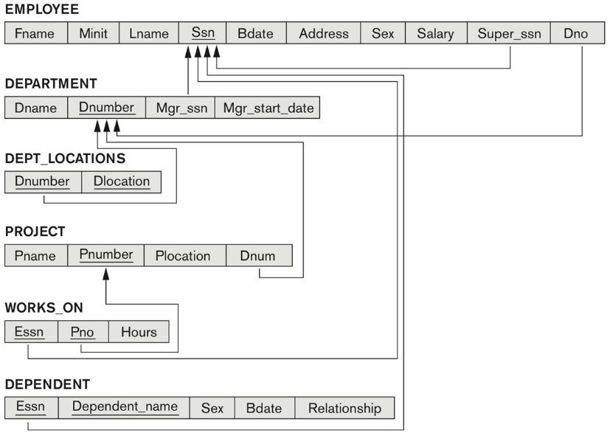
Relational Database Schemas
Relational database schema =
  Set of relation schemas + Set of integrity constraints
Integrity constraints:
  Restrictions on the data values used to ensure data accuracy and consistency in a database

Slide 9
What data constraints can be defined in a relational data model?

Slide 10
Schema-based constraints
Integrity constraints on schema includes
    Domain constraints
    Key constraints
    Constraints on NULLs
    Entity integrity constraints
    Foreign key constraints

Slide 11
Domain Constraints
Each value in a table column must be an atomic value from its domain
Domains are typically described by data types:
  Numeric data types for integers and real numbers
  Characters
  Booleans
  Fixed-length strings
  Variable-length strings
  Date, time, timestamp
  Money
  Other special data types

Slide 12
Key Constraints
The values in super-key columns must be unique
  “Super-key” = an attribute set which is able to uniquely identify a tuple in a relation
Superkey may contain redundant attributes
Think of the GRADE_REPORT relation

Slide 13
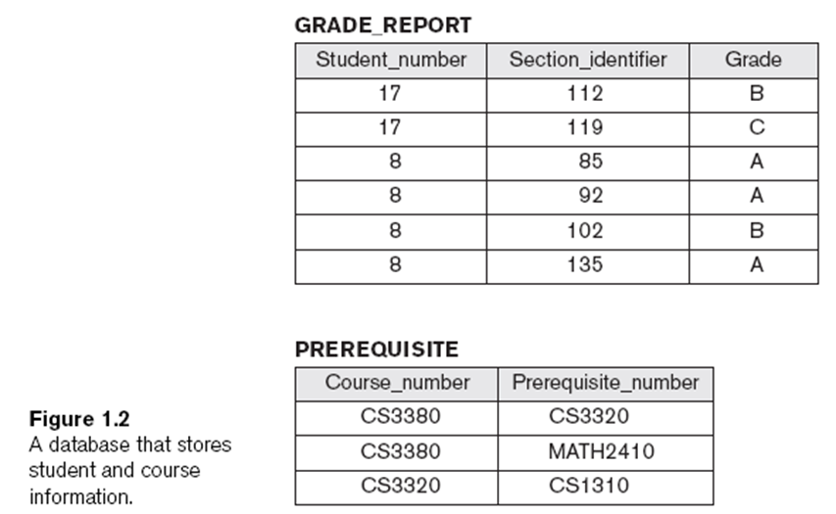
Key Constraints
Why Sec_id is not a super key?

Slide 14
Keys
An attribute set is a “key” if it meets two conditions:
  Is a superkey
    This attribute set is able to uniquely identify a tuple in a relation
  Is a minimal superkey (without redundant attributes):
    If we remove any attributes from it, then remaining set is not a superkey any more.
Think about the GRADE_REPORT relation

Slide 15
Another example
Example: Consider the CAR relation schema:
  CAR(State, Num#, VIN, Make, Model, Year)
  CAR has two keys:
    Key1 = {State, Num#}
    Key2 = {VIN}
  Both are also superkeys of CAR
  {VIN, Make} is a superkey but not a key.

Slide 16
Takeaways
In general:
  Any key is a superkey (but not vice versa)
  Any set of attributes that includes a key is a superkey
  The minimal superkey is key
  To identify (super)keys, you should focus on schema, rather than on user data.

Slide 17
Keys
“Candidate key” = Any key in a relation
  A relation may have more than one key
“Primary key” = A key selected as primary among candidate keys
  Underline primary key
All other non-selected candidate keys are called as unique/secondary/alternate keys

Slide 18

In-class practice
Can you find out the superkey, candidate key, primany key and unique key?

Slide 19
Constraints on NULL Values
For each attribute/column, we need to specify if NULL is acceptable or not in that column.

Slide 20
Entity integrity constraint
No primary key values can be NULL

Slide 21
Foreign key constraint
A Foreign Key (FK) is an attribute set which refers to a Primary Key (PK) in a relation.
Concretely, an attribute set is FK if it meets two conditions:
  The data types of FK must be the same as that of the PK
  Values in FK must be either (1) the values in the PK or (2) NULL values

Slide 22
In-class practice
In the COMPANY DB below, can you figure out the superkey, candidate key, primary key and unique key of each table?

Slide 23

COMPANY DB

Slide 24
Why we need foreign keys ?
Foreign key constraints are used to :
  keep data tables related
  keep data consistent among different tables

Slide 25
Takeaway: how to create a DB schema?
  1. Show the schema of each relation
  2. Underline the primary key of each relation
  3. Use directed arrow to show each foreign key, which goes from itself to the primary key it refers to

Slide 26

DB schema diagram with PK/FK specified

Slide 27
So far we learned five constraints
Integrity constraints on schema includes
    Domain constraints
    Key constraints
    Constraints on NULLs
    Entity integrity constraints
    Foreign key constraints
Is it possible that an operation issued by user may violate any constraint?

Slide 28
Constraint Violations
An operation issued by user may violate integrity constraint. If that is the case, by default, DB will reject such operation.
User may issue the following operations to DB:
  Insert
  Delete
  Update

Slide 29

INSERT may violate any of the constraints
  Domain constraint:
    if one of the attribute values provided for the new tuple is not in the specified attribute domain
  Key constraint:
    if the value of a key attribute in the new tuple already exists in another tuple in the relation
  Foreign key constraint:
    if a foreign key value in the new tuple references a primary key value that does not exist in the referenced relation
  Entity integrity:
    if the primary key value is null in the new tuple

Slide 30

DELETE may violate only foreign key constraint
If the primary key value of the tuple being deleted is referenced from other tuples in the database
      Examples?

Slide 31

UPDATE may violate any of the constraints
Key constraint
  Updating the primary key (PK)
Entity integrity
  Updating the primary key (PK)
Foreign key constraint:
  Updating the foreign key (FK)
Updating an ordinary attribute (neither PK nor FK):
  Can violate domain constraints

Slide 32
In-Class Exercise 1
Customer(custNo, name, email)
Order(orderNo, custNo, orderDate, handlingCost)
Product(productNo, prodName, listPrice)
Includes(orderNo, productNo, unitPrice, quantity)
Can you identify the primary keys and foreign keys for this schema?

Slide 33
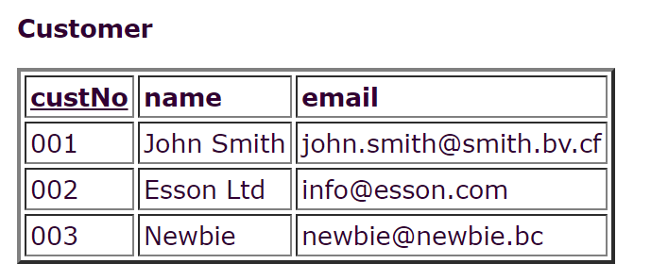
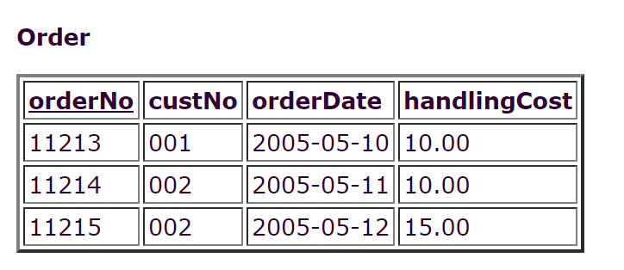
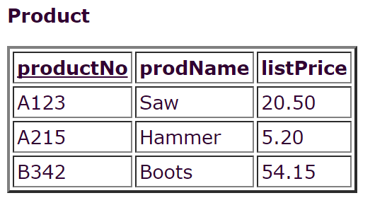
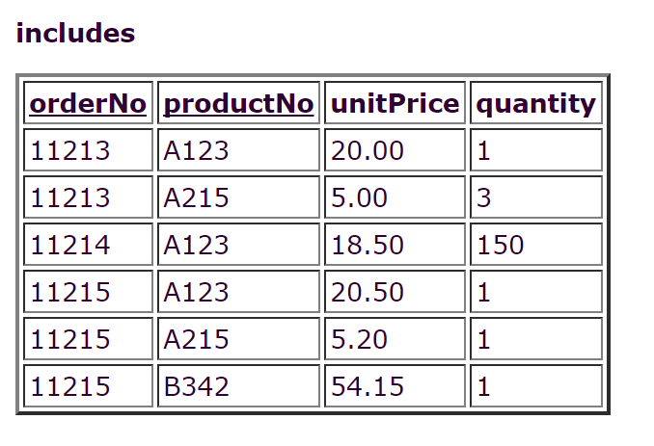
A Possible DB State…

Slide 34
In-Class Exercise 2
Consider the following database that keeps track of student enrollment in courses and the books adopted for each course:
STUDENT(SSN, Name, Major, Bdate)
COURSE(CourseId, Cname, Dept)
ENROLL(SSN, CourseId, Semester, Grade)
BOOK_ADOPTION(CourseId, Semester, Book_ISBN)
TEXT(Book_ISBN, Book_Title, Publisher, Author)
Can you identify the primary keys and foreign keys for this schema?

Slide 35
Video Recap on All Kinds of Keys

